Slide 1
MIKROPROCESORSKI SISTEMI 2 CONNECT FOUR
DEJAN ĐEKANOVIĆ

Slide 3
HARDVER
Easy 8051 ploča
AT89S8253 mikrokontroler
RGB 8x8 matrični displej
1 x TD62783AGP transistor array (source type)
2 x ULN2803A transistor array (sink type)
Otportnici 8 x 150R (zelena), 8 x 50R (crvena)

Slide 4
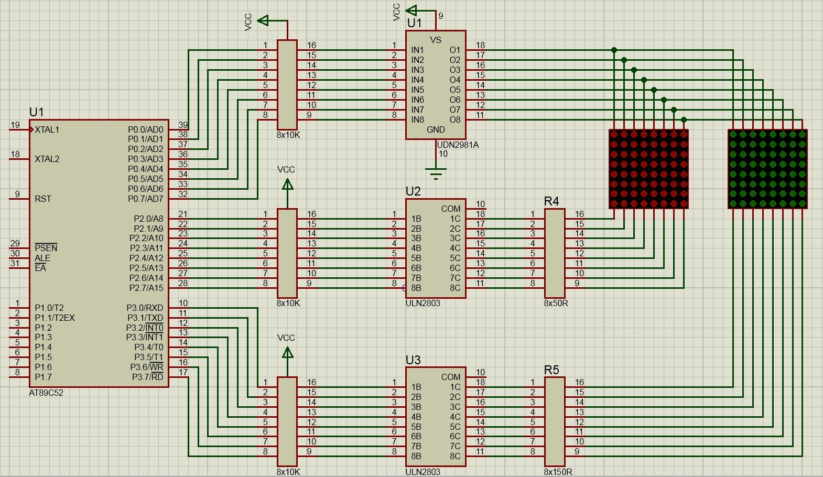

Slide 5
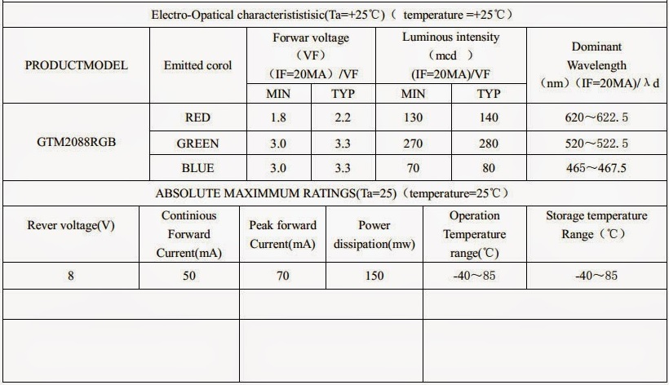

Slide 6
SOFTVERSKI MODULI
timer.c – modul za mjerenje proteklog vremena
display.c – drajver za matrični displej
graphics.c – modul za apstrakciju prikaza grafičkih elemenata
connectfour.c – modul za apstrakciju igre

Slide 7
TIMER
void Timer_Init();
unsigned long Timer_Miliseconds();
void Timer_Tick();

Slide 8
DISPLAY
void Display_Init();
void Display_SetOutput(unsigned char row, unsigned char red,
unsigned char green);
void Display_Refresh();

Slide 9
GRAPHICS
void Graphics_SetPixel(unsigned char row, unsigned char column,
Color color);
void Graphics_VerticalLine(unsigned char column, unsigned char rowStart, unsigned char rowEnd, Color color);
void Graphics_HorizontalLine(unsigned char row, unsigned char columnStart, unsigned char columnEnd, Color color);
void Graphics_ClearDisplay();

Slide 10
CONNECTFOUR
void ConnectFour_Init();
unsigned char ConnectFour_InsertDisc(unsigned char column);
void ConnectFour_SwitchPlayer();
unsigned char ConnectFour_CheckWinner();
void ConnectFour_TurnWinnersDiscs(unsigned char onOff);
void ConnectFour_NewGame();

Slide 11
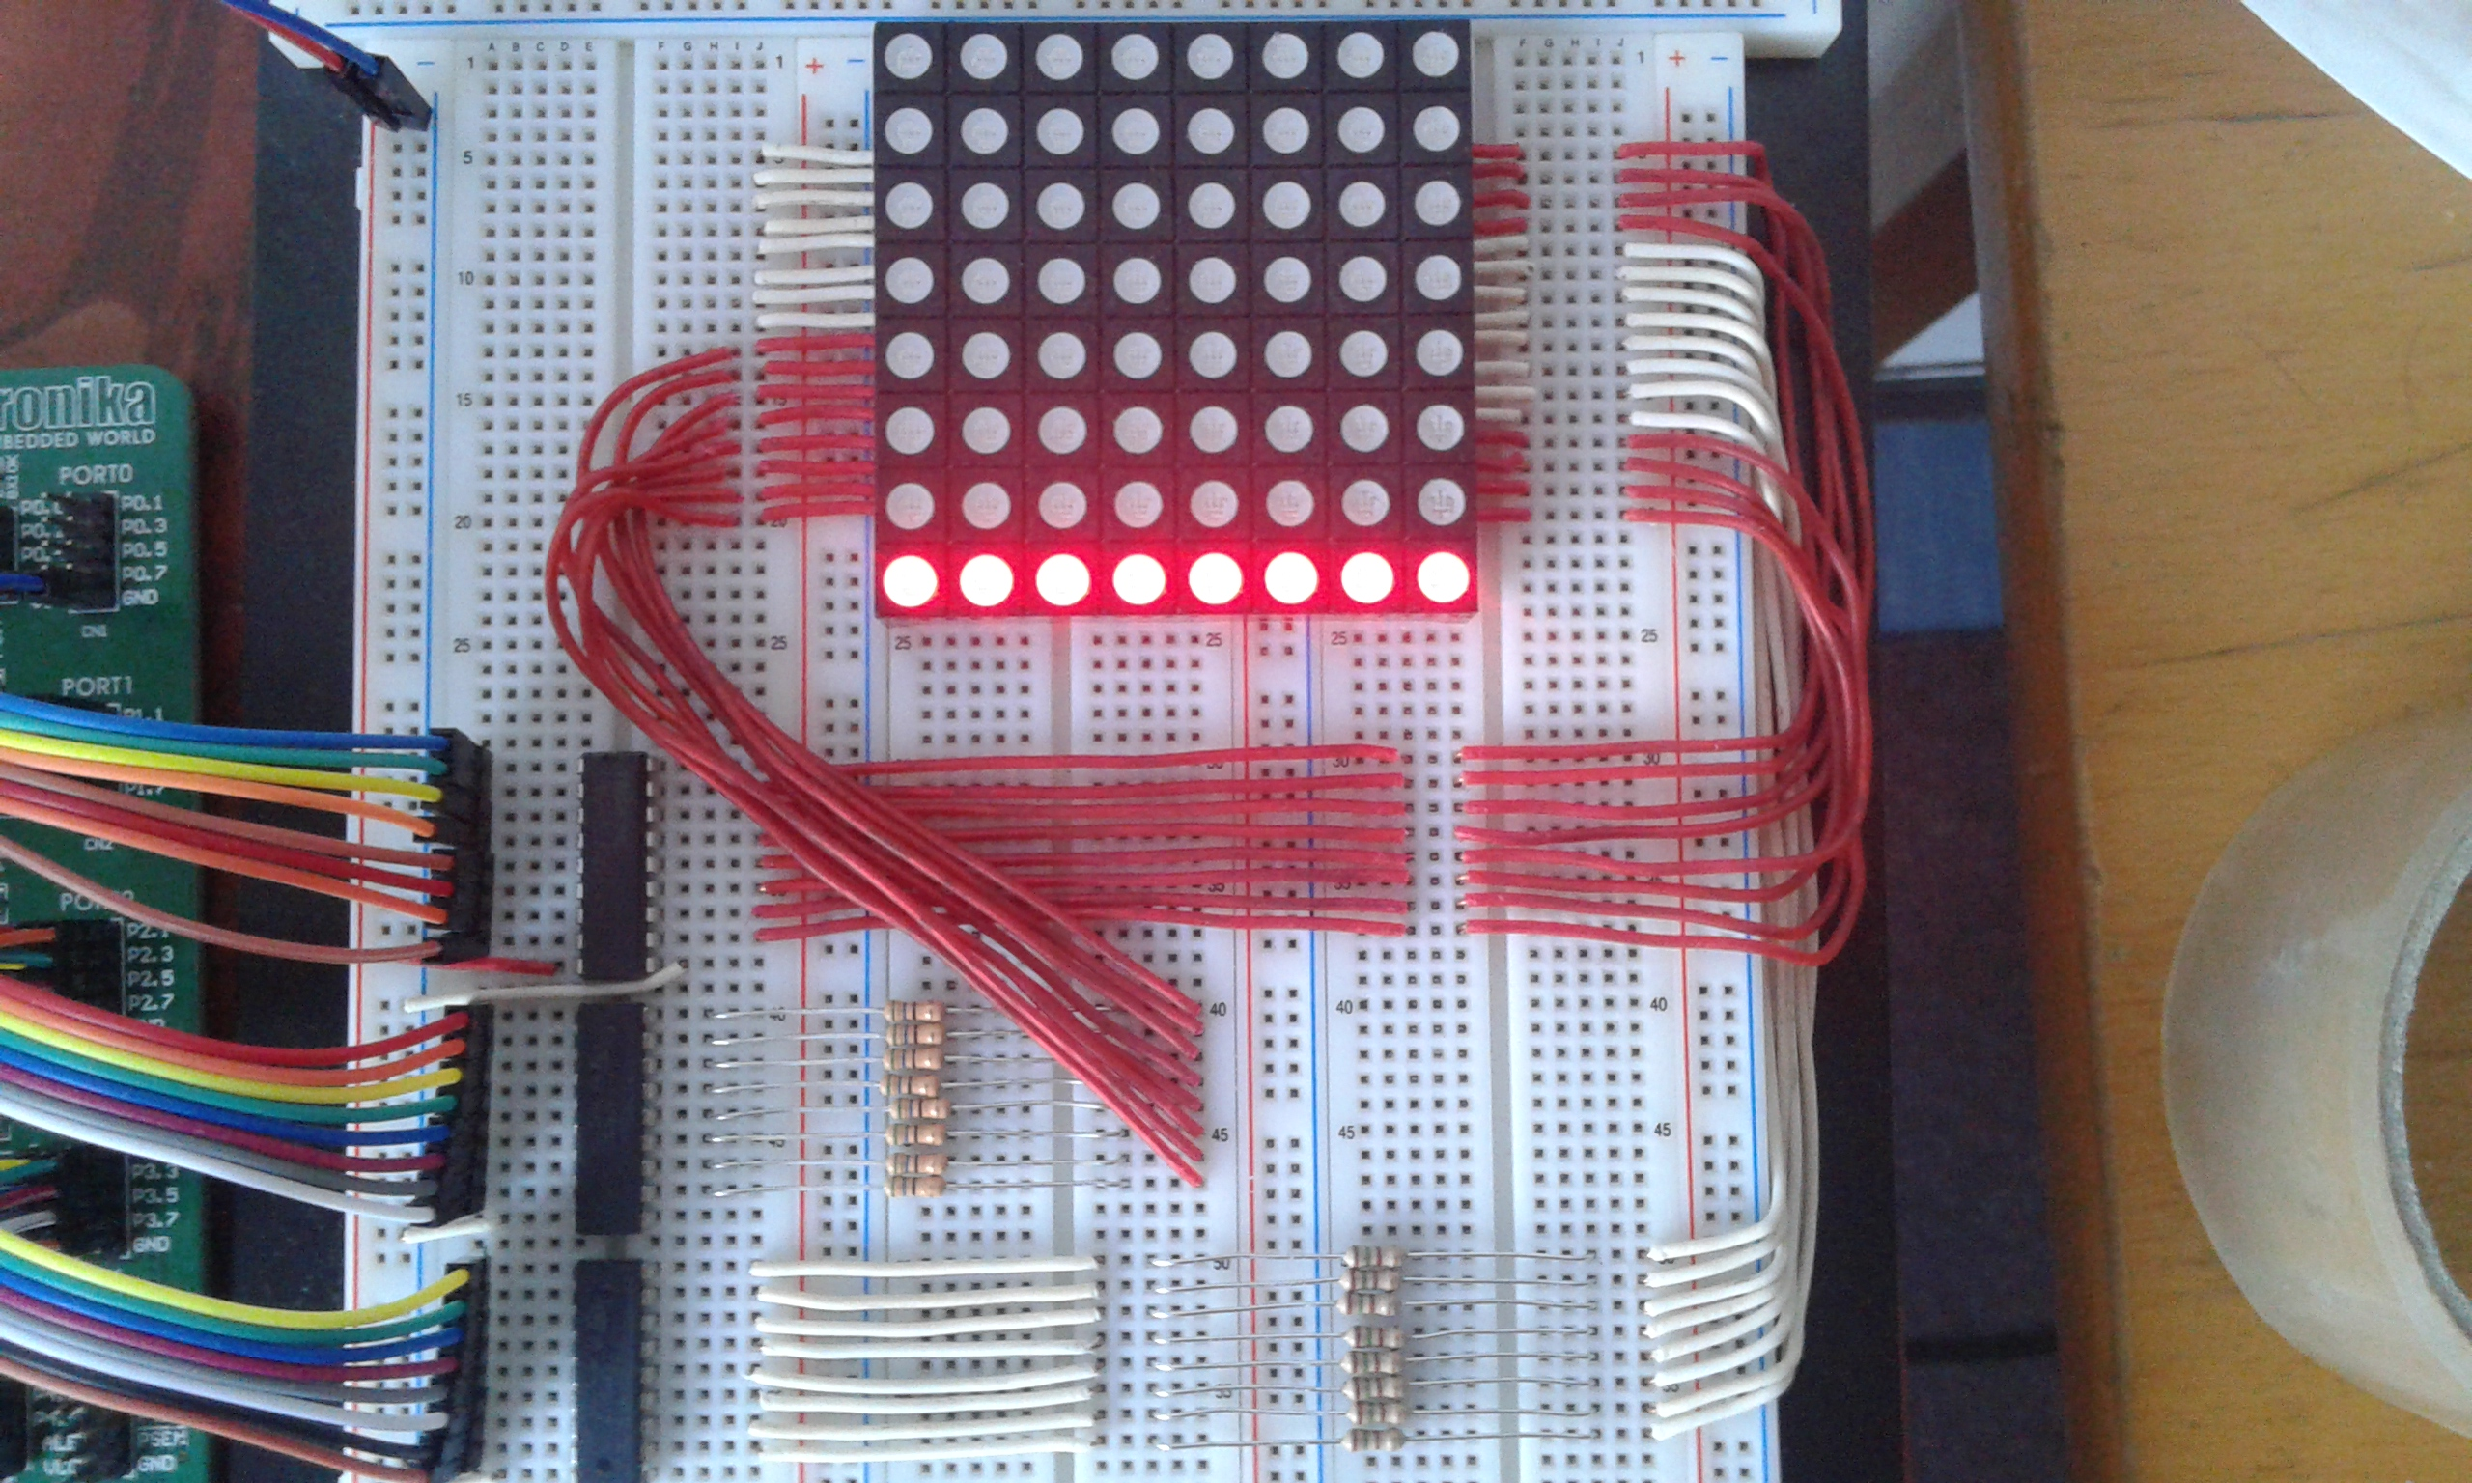

Slide 12
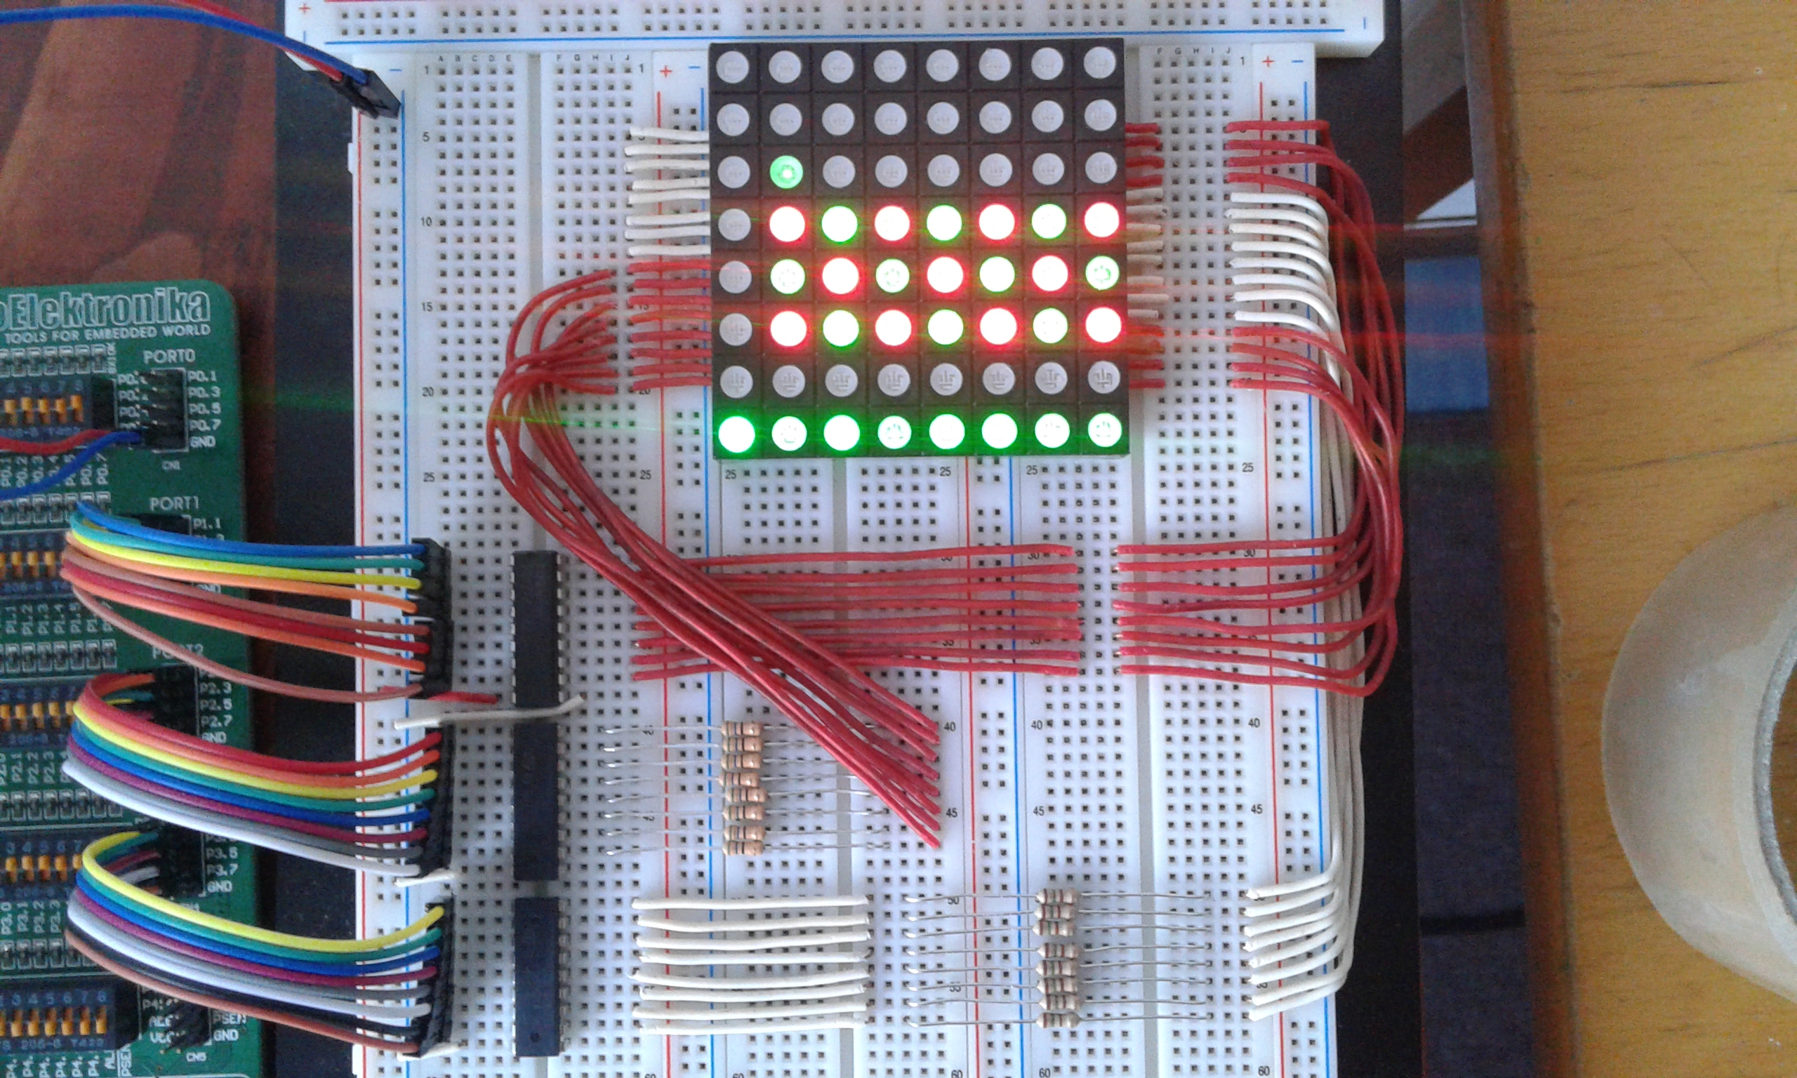

Slide 13
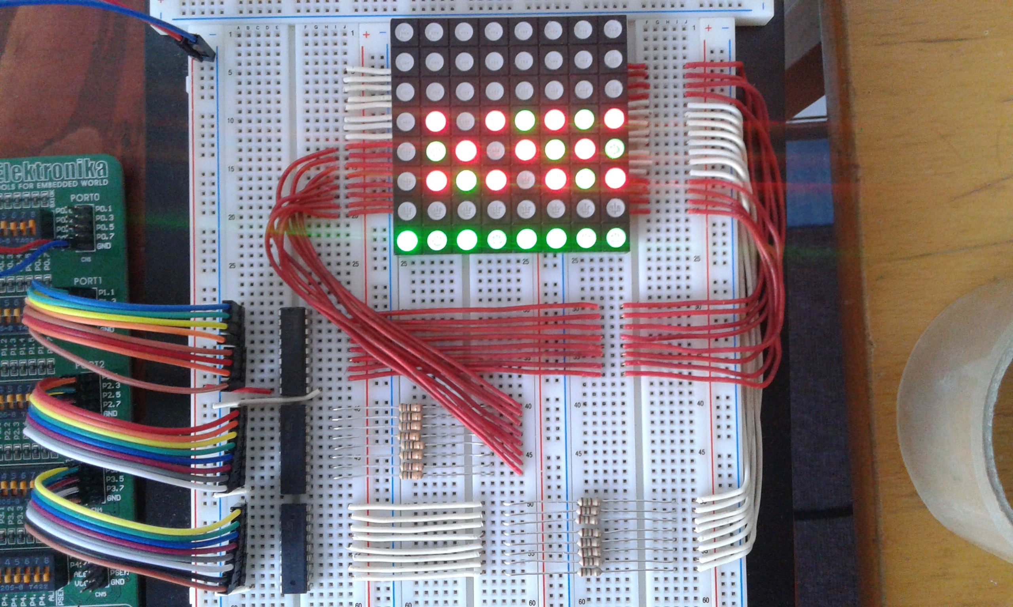

Slide 14
Hvala na pažnji.

